Slide 1
Project Title : Smart Water Management
Phase -II

Slide 2
Project Definition:
In order to monitor water levels and proper maintenance of water via a public platform. The project entails placing IOT sensors in the public.The goal is to maintain the tank without bacteria and microbes and then they are integrated using Python and IOT technology.
Introduction:
The monitoring of water quality is extremely important for maintaining the safety of water resources used for various purposes such as drinking, recreation or food processing. Water quality is determined by interdependent chemical, physical, and microbial factors, including but not limited to pH, turbidity, conductivity, and water level in the tank.
Many conventional water quality monitoring technologies lack integration, are labour-intensive, time-consuming, and expensive. Typically, in many systems, only one parameter such as free chlorine or pH is measured at a time. The water quality parameters pH measures the concentration. It shows the water is acidic or alkaline.

Slide 3
Objectives:
The main objectives of the project are:
Minimize usage of water usually utilized in higher amounts for manufacturing, agriculture, and power production.
Establish public policies with the help of real-time data gathered by IoT devices.
Detect leakage and spillage, and where exactly they are occurring.
Reduce energy and vitality to make use of the least amount of resources while providing ample water.
IoT sensor Network design:
The sensors placed at the different places reads the data which are manipulated through the microcontroller and the values of the sensors are displayed. The values obtained repeatedly are send to database and through the web API, warning message is sent into the phone.
The single chip microcontroller named ATMEGA 328p was used. It is used to collect the data from the sensor and post to main unit through wireless transceiver. It has 14 digital I/O pins, of which 6 can be used as PWM outputs and 6 analog input pins. These I/O pins account for 20 of the pins. 2 of the pins are for the crystal oscillator. This is to provide a clock pulse for the ATMEGA chip. A clock pulse is needed for synchronization so that communication can occur in synchrony between the ATMEGA chip and a device that it is connected to. The chip needs power so 2 of the pins, VCC and GND, provide it power so that it can operate. The Atmega328 is a low-power chip, so it only needs between 1.8-5.5V of power to operate. The Atmega328 chip has an analog-to-digital converter (ADC) inside of it. This must be or else the Atmega328 wouldn't be capable of interpreting analog signals. Because there is an ADC, the chip can interpret analog input, which is why the chip has

Slide 4
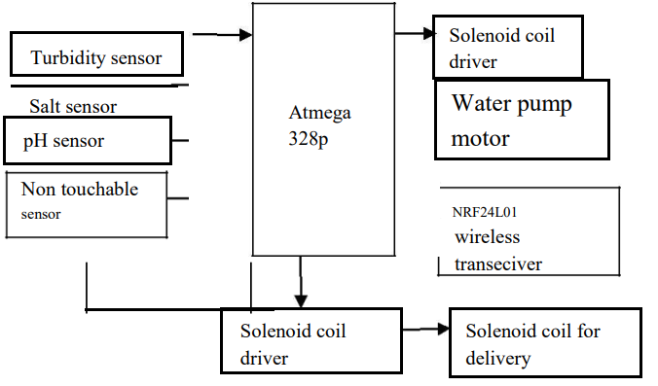
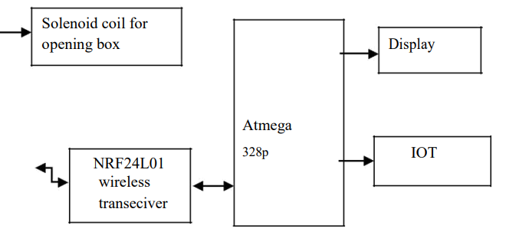
Basic Block diagram

Slide 5
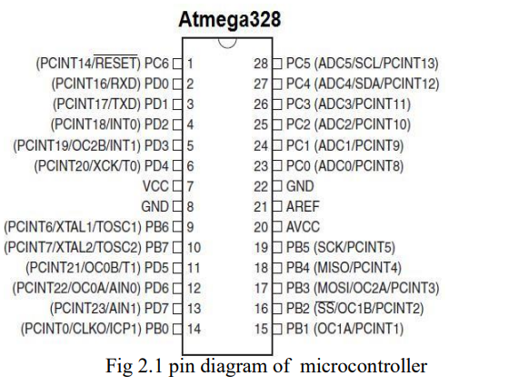
Hardware Description:
ATMEGA 328p:
Micro Controller- TheAtmega328isa one of the very popular microcontroller chip produced by Atmel It is an 8 - bit microcontroller that has32Kof flash memory, 1K of EEPROM, and2K of S RAM. The Atmega328 is one of the microcontroller chips that are used with the popular Arduino boards. This microcontroller has analog pin and digital pin for easy interface of the = Microcontroller Operating Voltage: – 1.8 - 5.5V23 Programmable I/O Lines Two 8-bit Timer/Counters Real Time Counter with Separate Oscillator Six PWM Channels6- channel 10-bit ADC

Slide 6
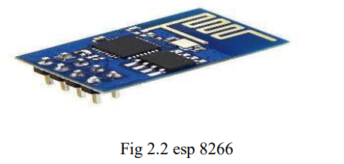
ESP 8266:
Wi-Fi Direct (P2P), soft-AP Integrated TCP/IP protocol stack+19.5dBm output power in802.11b mode Supports antenna diversity Power down leakage current of < 2msStandby power consumption Operating Voltage. The esp8266 module it is a 8 pin . VCC is a power supply and it is operated by the voltage is 3.3v .This exceed and it is burn the ESP module. GND is connected to the ground terminal. Rx pin is the receiver pin UART serial communication The Tx pin is a transmitter. GPIO general purpose input and output. Reset pin reset the module apply in 3.3v. the CH-PD pin configure channel.
NRF 2401L:
The NRF wireless trans-receiver is 8 pin of the operation. GND pin it is also used to for the ground terminal. VCC is a power supply operated by the voltage range is 1.9v to the 3.6v and it is mostly apply the 3v . The CE pin is a select the mode of operation either is operated by transmit data or receive a data. CSN it is used to for the enable the SPI chip. SPI pro vise is high the clock is enable and low the clock is dis-able. MOSI transmit a data from user module to the external circuit. It has following pin name Serial Peripheral Interface, or SPI is a very common communication protocol used for two-way communication between two devices. A standard SPI bus consists of 4

Slide 7
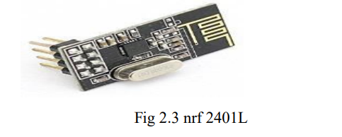
signals, Master Out Slave In (MOSI) Master In Slave Out (MISO), the clock (SCK), and Slave Select (SS)An SPI bus has one master and one or more slaves .The master can talk to any slave on the bus, but each slave can only talk to the master. Each slave on the bus must have it's own unique slave select signal. The master uses the slave select signals to select which h slave it will be talking to.
Salt Sensor:
It is used to monitoring the salt content of the sewage water and communicate with microcontroller for posting this information to internet. It has consists of two rods one is reference rod and measuring rod. The voltage is given to the reference rod and the conducting current passes to measuring rod. The voltage present in the measuring rod is proportional to the salt content of the water.
pH Sensor:
pH sensor used to determine the pH value content in the water. The pH value range from the acidity – Neutral – Alkaline. It has two rod to measure the value of the pH value in the water. The pH meter is used for the quality check if water is safe for drinking. A balanced pH level is very important for human health; it should be

Slide 8
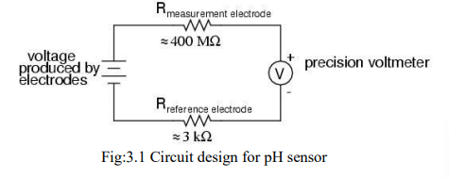
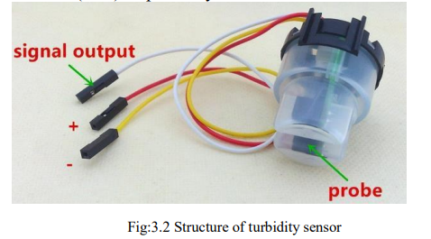
approximately equal to 7. It gives Full range pH reading from 1 to 5 voltage scale range and given.
Turbidity Sensor:
The turbidity sensor SKU: SEN0189 is used to detect water quality by measuring level of turbidity. The turbidity sensor enables the detection of suspended particles in water by measuring the light transmittance and analogue and digital signal output modes, either of the mode can be selected according to the microcontroller unit (MCU). The threshold is adjustable by adjusting the potentiometer in digital signal mode. The operating voltage of the turbidity sensor is 5V DC and the operating current is 40mA (max) respectively.
es a Single reading.

Slide 9
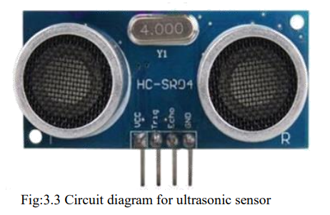
Ultrasonic Sensor:
This is used to measure the level of the water in the Tank in term of distance from top to surface of water. The distance value shown in Centi-meter in display unit. From this sensor we find the level of the water level. This ultrasonic sensor is operated by emitting high-frequency sonic wave at regular time interval starting from the front of the transducer. The sonic waves are reflected by an object and received back in the transducer. The time interval between emitting and receiving sound waves is proportional to the distance between the transducer and the object can be calculated. As the ultrasonic sensor is using sound wave instead of light wave, it is more suitable for sensing uneven surface such as water surface. According to its datasheet, the ultrasonic sensor detects objects from 0-inches to 254-inches (6.45- meters) and provides sonar range information from 6-inches out to 254-inches with 1-inch resolution.

Slide 10
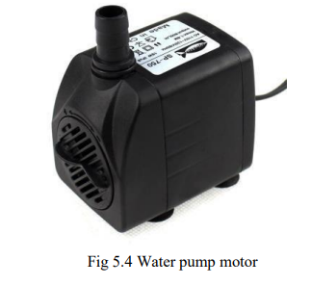
Solenoid value of water:
A solenoid is a simple device that converts electrical energy into linear mechanical motion, but it has a very short stroke (length of movement), which limits its applications. The solenoid consists of a coil of wire with an iron plunger that is allowed to move through the center of the coil. Above figure shows the solenoid in the unenergized state. NRF24L01 wireless trans-receiver ATMEGA 328p IOT A solenoid valve is the combination of a basic solenoid and mechanical valve. So a solenoid valve has two parts namely- Electrical solenoid, mechanical valve. Solenoid converts electrical energy to mechanical energy and this energy is used to operate a mechanical valve that is to open, close or to adjust in a position.
Water pump motor:
This is a mini submersible type water pump that works on 12V DC. It is extremely simple and easy to use. Just immerse the pump in water, connect a suitable pipe and power the motor to start pumping water. Great for building science projects, fire-extinguishers, fire fighting robots, fountains, waterfalls, plant watering systems etc. This motor is small, compact and light. It is manufactured to be used in automobiles for spraying wiper water, hence it is quite durable. It can be controlled from a micro controller/Arduino using our DC Motor Drivers or one of our Relay Boards

Slide 11
Integration and Approach:
An internet-based approach to measuring water quality and delivery systems on a real-time basis. The results of the various parameters of water quality are verified that the system achieved the reliability and feasibility of using it for the actual monitoring purposes. The WSN network will be developed in the future comprising of more number of nodes to extend the coverage range. In our proposed system, water level can be monitored continuously from anywhere using web browser. Motor can be controlled automatically full smart automation is achieved. It is a robust system & small in size. This Project uses ultrasonic sensors which provide more accurate and calibrated information for water level in tank. An electromagnetic box is used to drop the chlorine power in the tank by automated system and show the various parameter of water in a web browser that can be viewed any whereby user.

